Slide 1



Financial Services Cloud Migration: Implementation Insights
Palash Bhatnagar

Slide 2
Agenda
Introduction
Cloud Migration Process
Challenges
Wave Planning and Runbook
Network Architecture Planning

Slide 3

Introduction
"Today, we delve into our financial services client's ambitious journey into the cloud. Facing the demands of a rapidly evolving landscape, they are strategically transitioning to a cloud-based infrastructure. This move isn't just about adopting new technology; it's a fundamental shift in how they operate and deliver services. Strategic planning is the cornerstone of this initiative, ensuring a seamless and optimized migration that aligns with the client's overarching business objectives. Let's explore why strategic planning is key to their successful cloud adoption."
3

Slide 4


Cloud Migration Case
Multi Cloud/Hybrid Migration
“Our financial services client is embarking on a multi/hybrid cloud-based transformation and wants to understand the implementation aspects of cloud migration such as wave planning and runbook creation.”

Slide 5
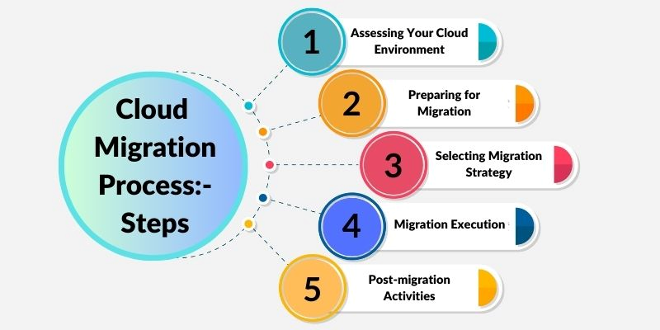
Cloud Migration Process

Slide 6

Challenges
Data Security and Compliance: Ensuring the confidentiality and integrity of sensitive financial data while adhering to industry-specific regulations.
01
Legacy System Integration: Integrating and migrating legacy financial systems, often characterized by intricate dependencies and proprietary technologies.
02
Regulatory Considerations: Navigating complex regulatory landscapes and ensuring compliance with financial industry regulations in both the source and target environments.
03
Operational Disruptions: Mitigating the risk of operational disruptions during the migration process, especially critical for financial services where downtime can have significant consequences.
04
05
Cost Management: Effectively managing costs associated with the migration, including potential unexpected expenses and optimizing ongoing cloud expenses.

Slide 7
Metrics to be Considered
Downtime
Data Integrity
Compliance Adherence
User Experience
Scalability and Performance
Data Transfer Speed
Minimizing downtime to ensure uninterrupted financial services and operations during the migration process. Reduced downtime ensures business continuity and prevents disruptions to financial operations
Ensuring efficient and rapid transfer of financial data to the cloud, minimizing the impact on day-to-day operations. Faster data transfer reduces the overall migration timeline, minimizing the impact on day-to-day operations
Maintaining the integrity and accuracy of financial data throughout the migration process. Maintaining data integrity is critical for regulatory compliance and preventing financial discrepancies
Regularly validating and ensuring compliance with financial industry regulations, both during and post-migration. Compliance is paramount in the financial sector; deviations can lead to legal consequences and financial losses
Assessing the impact on end-user experience, guaranteeing seamless access to financial services for clients and internal users. A positive user experience is crucial for client retention and internal operational efficiency, even amid the migration process
Evaluating the cloud environment's ability to scale and meet the performance requirements of financial applications and services. Ensuring that the cloud infrastructure can handle varying workloads and maintain optimal performance is crucial for a successful migration

Slide 8
Wave Planning
Wave planning is the idea of bundling associated applications for transition and/or transformation into the cloud, balancing resources, synergies, risks for the migration and business
Evaluating Current Infrastructure
Understand the existing IT landscape, infrastructure, and applications.
Identifying dependencies, potential challenges, and opportunities for optimization.
Assessing the Dependencies
Grouping the applications based on their interdependencies and relationships with each other.
Ensuring that applications with shared dependencies are migrated together, reducing disruptions and maintaining functionality.
Criticality Planning
Establish a priority order for migrating applications basis the criticality
Allow deep focus on critical applications first, minimizing the impact on core business functions.
Testing and Validation
Develop a comprehensive plan for testing applications before and post migration.
Validates that applications function as expected in the cloud environment, reducing the likelihood of post-migration issues.
8

Slide 9





Runbook
Runbooks act as the guiding scripts, they represent a comprehensive playbooks, providing detailed instructions for every migration task.
Planning
Dependencies
Troubleshooting
Rollback Procedures
Validation and Testing
Define each migration task, outlining the specific actions to be taken.
Identify and document dependencies between different tasks and systems.
Include detailed instructions for identifying and resolving common issues
Discuss and draft steps to revert changes in case of unexpected issues or failures.
Outline strategic criteria and benchmarks for validating the success of each migration task

Slide 10





Network Architecture Planning
Inventory and Documentation
Understanding the comprehensive inventory of all network assets, including servers, switches, routers, and their configurations.
Understand the current architecture, dependencies and interactions
Security and Network Assessments
Identify VLANs in the current environment, firewall, VPN, AV and map them to cloud.
Engage with Security leaders to understand their services and provide deliverables on SecOps maintaining network segmentation and security.
Bandwidth Analysis
Analyze the flow of traffic within the current network, identifying patterns and dependencies.
Evaluate bandwidth requirements for each application and service in the current network
Redundancy and Failover Planning
Identify and plan for redundancy and failover configurations in the cloud network architecture
Planning for high availability and resilience post migration
10

Slide 11




Thank you
Palash Bhatnagar

